Slide 1
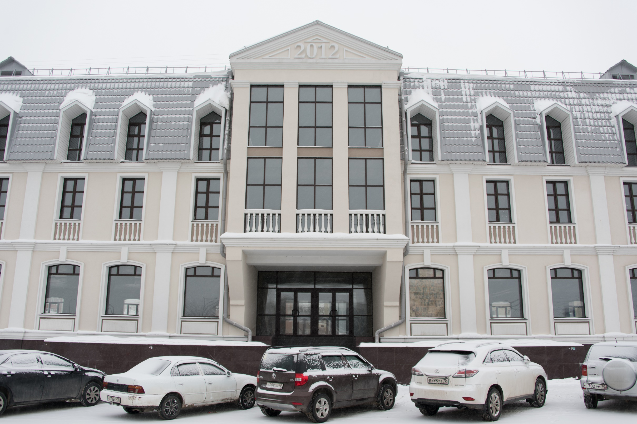
Premises Renting/Leasing to locate the TSU School of Innovation, Economics and Management

Slide 2
Location of the building
Place of Tomsk’s foundation
Big Concert Hall of Tomsk Philharmonic
Tomsk Region Administration
The proposed building

Slide 3
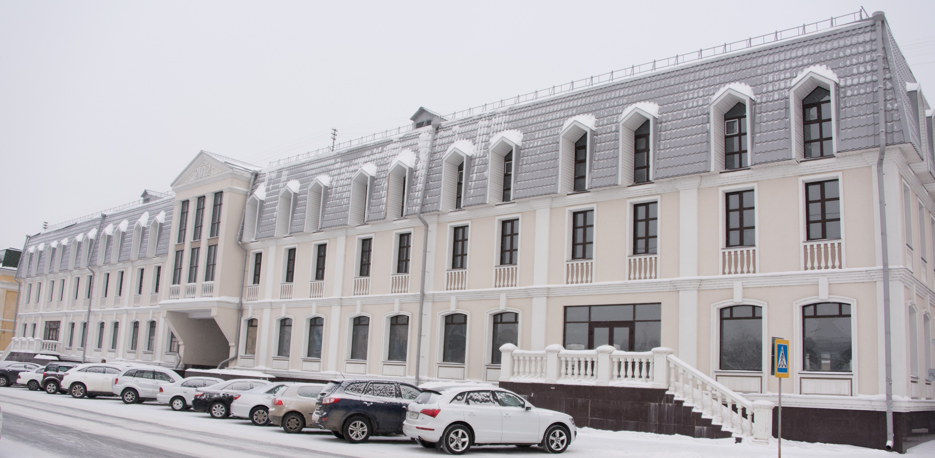
Characteristics of the building
Year of construction 2012
Dimensions 70 x 20 meters
Floor area 1,400 m²
Number of storeys 4 (including ground floor and mansard roof)
Total area 5,600 m²

Slide 4
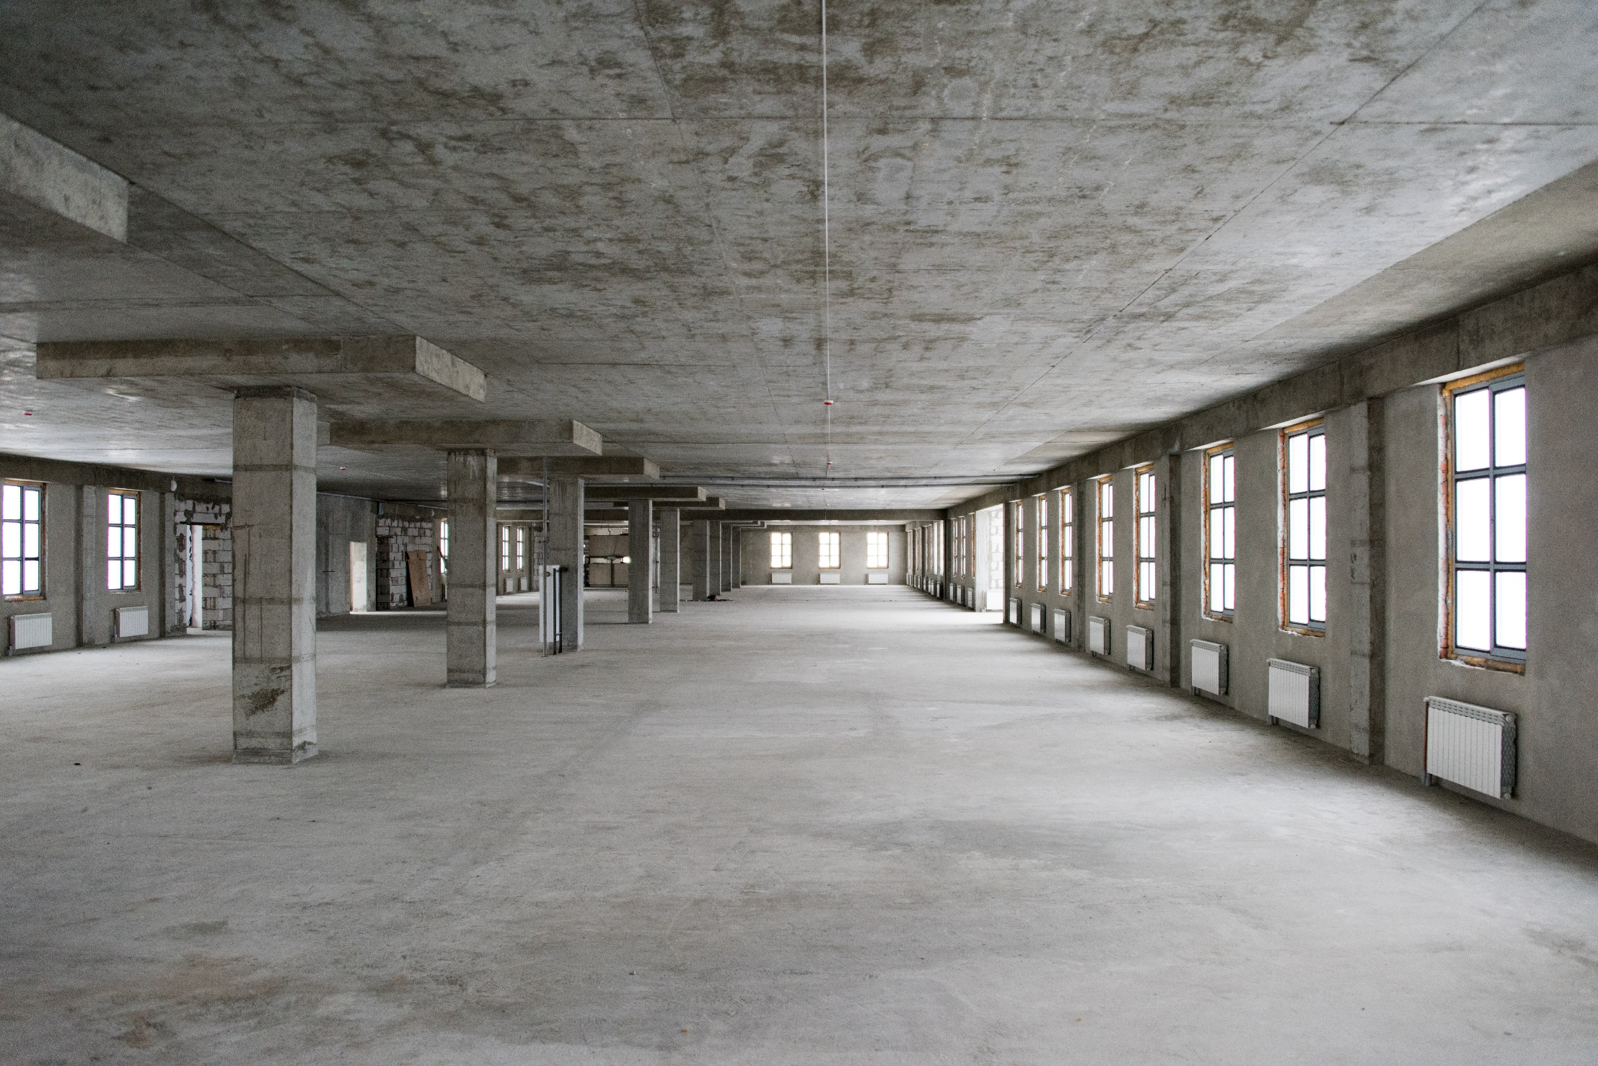

Slide 5
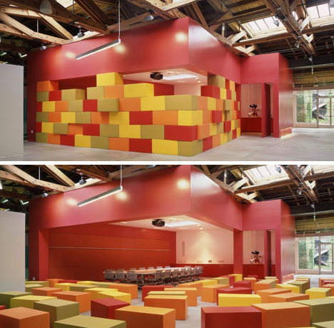
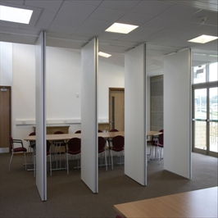
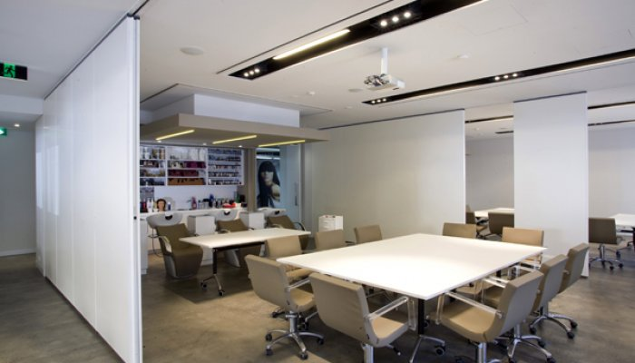
The construction of the building is favorable for the development of modern transformable educational spaces with the use of mobile walls of various types

